Slide 1


Separating Logic and UI
Jeff Lefebvre
Embarcadero MVP, TP
@PascalCoder @DelphiTips
KiwiStamp.ca
http://LinkedIn/in/JeffLefebvre

Slide 2
A Successful Long-term Application
Easy to Maintain
Easy to Test
High Revenue and Low Risk to the Company

Slide 3
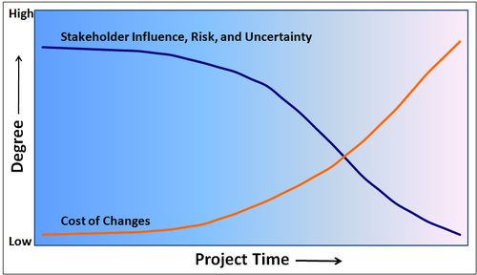
Risk
Adding Maintainability and Testability reduces Risk in your project

Slide 4
What does Seperating UI and Logic Do?
More Platforms (More Revenue)
Better Scalability (Less Cost)
Better Maintainability (Less Cost)
Better Testability (Less Cost)
Less Risk (Less Cost)

Slide 5
Demo

Slide 6
Other Source Control Systems
Free on-premesis:
Perforce (free for small teams)
Subversion (Open Source)
Git
Free Hosted (look at terms):
GitHub
bitbucket
Assembla
Unfuddle

Slide 7
Separating Logic and UI
Jeff Lefebvre
Embarcadero MVP, TP
@PascalCoder @DelphiTips
KiwiStamp.ca
http://LinkedIn/in/JeffLefebvre

